Slide 1
Deep Learning for NLP: TEXT TRANSLATION
Jay Urbain, PhD
Professor, Electrical Engineering and Computer Science Department
Milwaukee School of Engineering
urbain@msoe.edu
July 2018

Slide 2
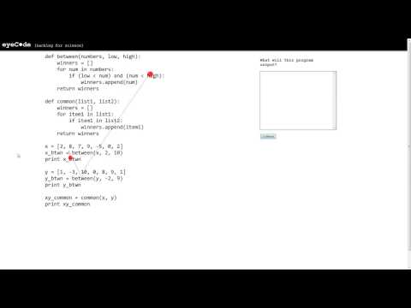
HUMAN ATTENTION FOR REASONING

Slide 3
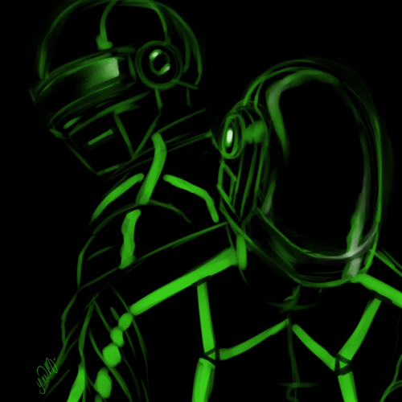

WHY GIVE ATTENTION TO DEEP LEARNING?
Better interpretability
Faster models
Stronger results
Slide idea: J. Redmon, YOLO 9000 presentation
Picture from tumblr

Slide 4


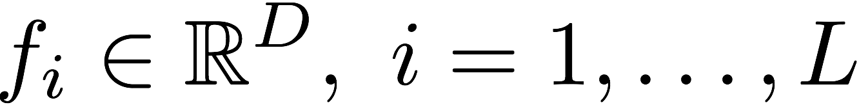


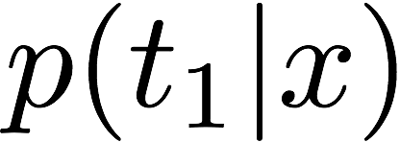

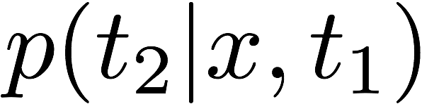



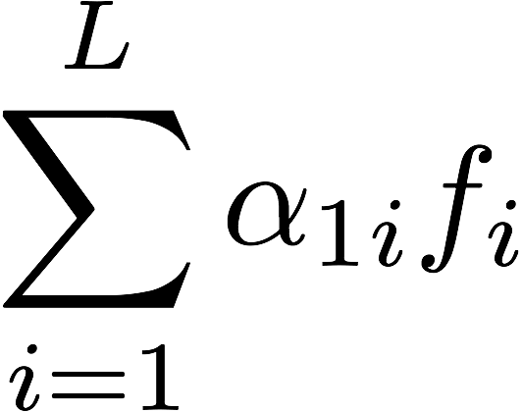
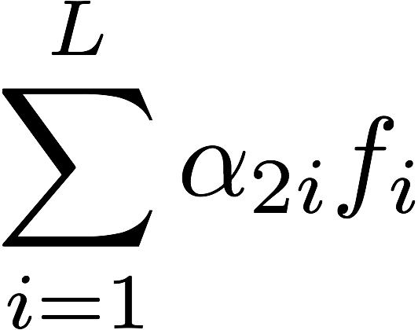
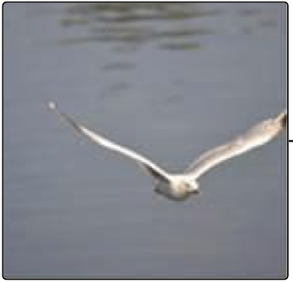
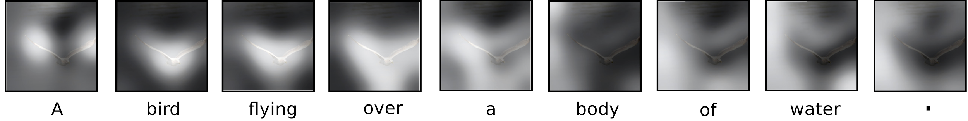
SOFT ATTENTION FOR IMAGE CAPTIONING
a
bird
D features
L positions
...
convnet
weighted average of features
Xu et al. “Show, Attend and Tell: Neural Image Caption Generation with Visual Attention” ICML 2015
Notes:
Add "doubly stochastic attention" slide? (enforce that the model looks at every position during the text generation)

Slide 5
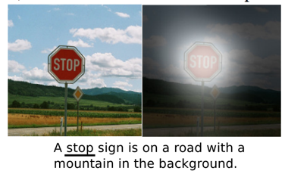
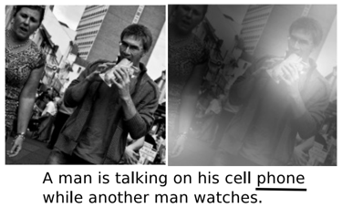
INTROSPECTION VIA SOFT ATTENTION
Xu et al. “Show, Attend and Tell: Neural Image Caption Generation with Visual Attention” ICML 2015

Slide 6
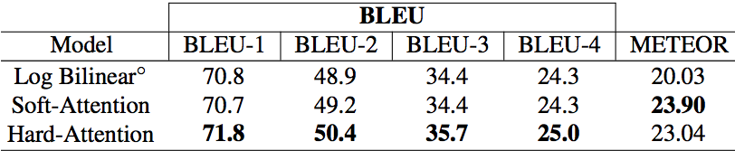
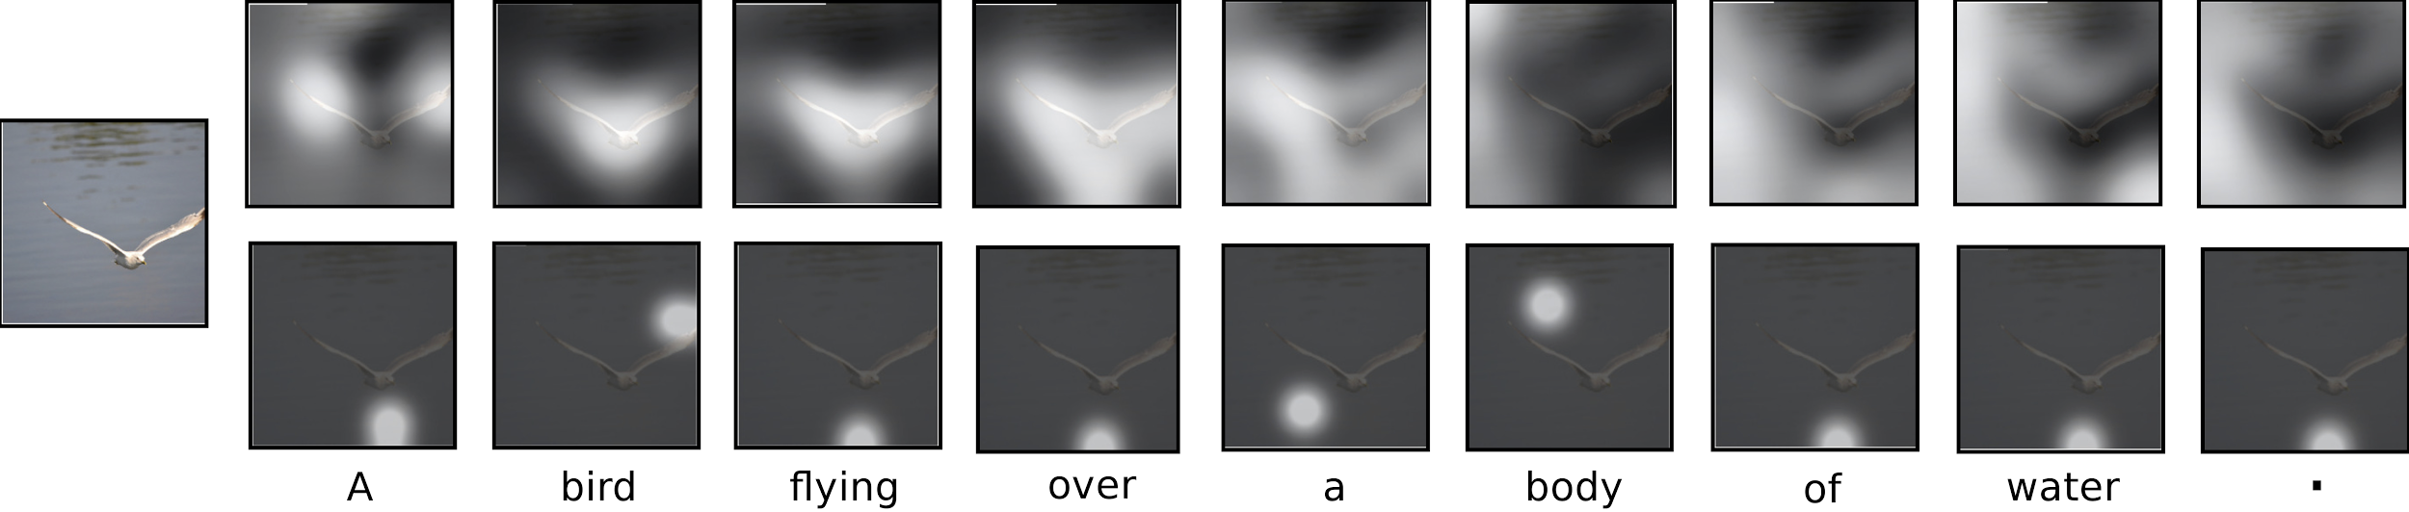
SOFT VS. HARD ATTENTION
Hard attention
Better results (sometimes?)
More principled
Hard to train
Soft attention
Not always applicable
Easy to train
soft
hard
Xu et al. “Show, Attend and Tell: Neural Image Caption Generation with Visual Attention” ICML 2015

Slide 7
NEURAL MACHINE TRANSLATION AND LONG SENTENCES
Early in the year 1806 Nicholas Rostov returned home on leave. <EOS>
decoder
1000 numbers
encoder
В начале 1806 года Николай Ростов вернулся в отпуск. <EOS>
Leo Tolstoy "War and Peace", 1869

Slide 8
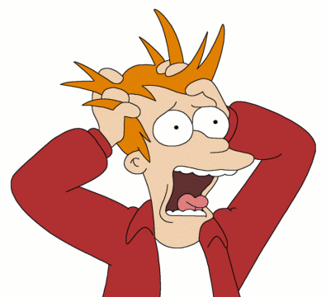
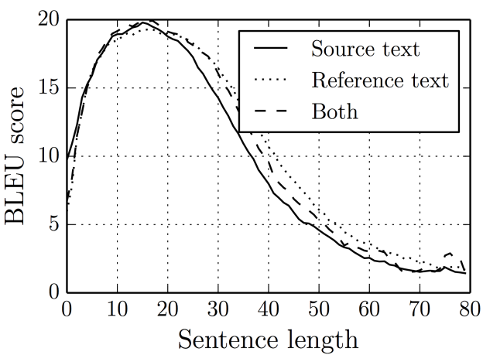
NEURAL MACHINE TRANSLATION AND LONG SENTENCES
Meeting a comrade at the last post station but one before Moscow, Denisov had drunk three bottles of wine with him and, despite the jolting ruts across the snow-covered road, did not once wake up on the way to Moscow, but lay at the bottom of the sleigh beside Rostov, who grew more and more impatient the nearer they got to Moscow. <EOS>
decoder
1000 numbers
encoder
На предпоследней станции, встретив товарища, Денисов выпил с ним три бутылки вина и подъезжая к Москве, несмотря на ухабы дороги, не просыпался, лежа на дне перекладных саней, подле Ростова, который, по мере приближения к Москве, приходил все более и более в нетерпение. <EOS>
Leo Tolstoy "War and Peace", 1869
Cho et al. "On the Properties of Neural Machine Translation: Encoder-Decoder Approaches", 2014

Slide 9
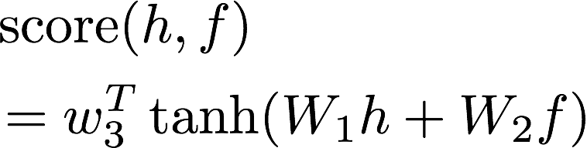
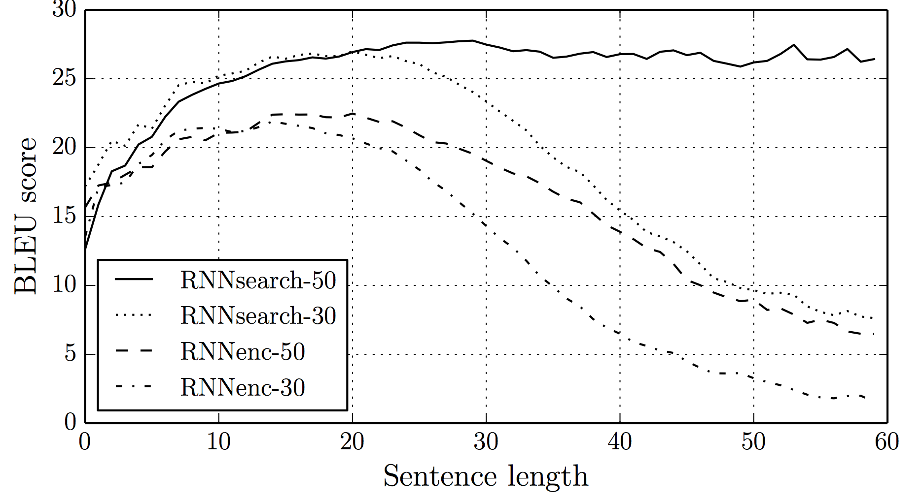
SOFT ATTENTION FOR NEURAL MACHINE TRANSLATION
meeting
a
with attention
...
encoder LSTM states
without attention
на предпоследней станции встретив товарища
Bahdanau et al. "Neural Machine Translation by Jointly Learning to Align and Translate", 2014

Slide 10
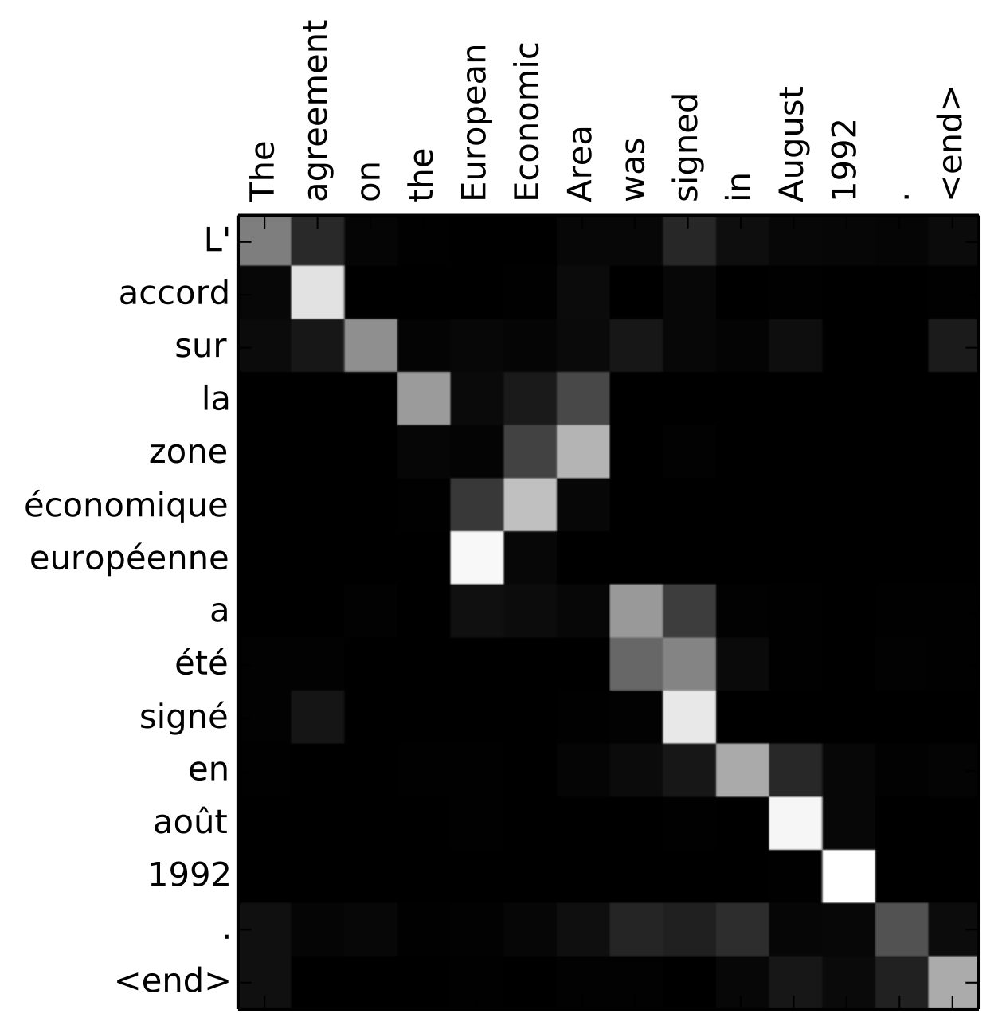
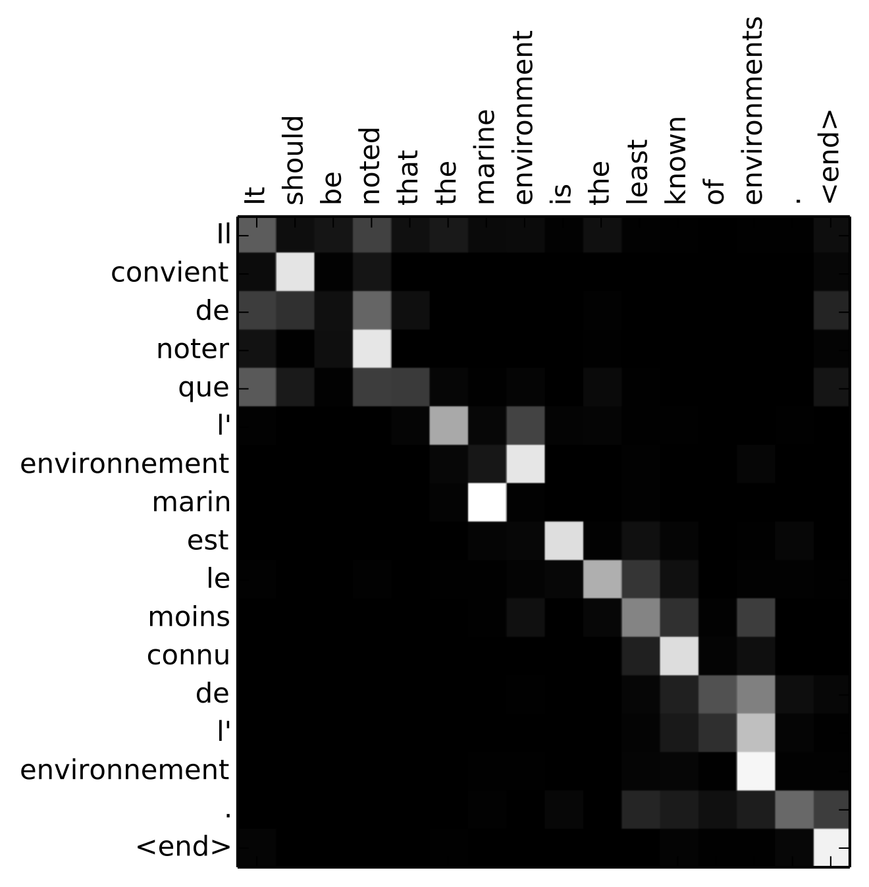
ATTENTION MAPS IN TRANSLATION
source language (English)
source language (English)
target language (French)
target language (French)
Bahdanau et al. "Neural Machine Translation by Jointly Learning to Align and Translate", 2014

